Slide 1
Object Oriented Programming CS F213 Amit Dua
Slide material from book “Head First Design Patterns”

Slide 2
Command Pattern

Slide 3
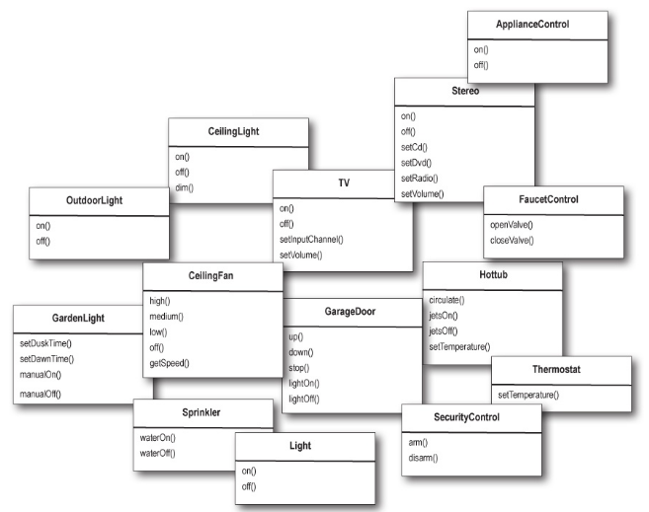

Slide 4
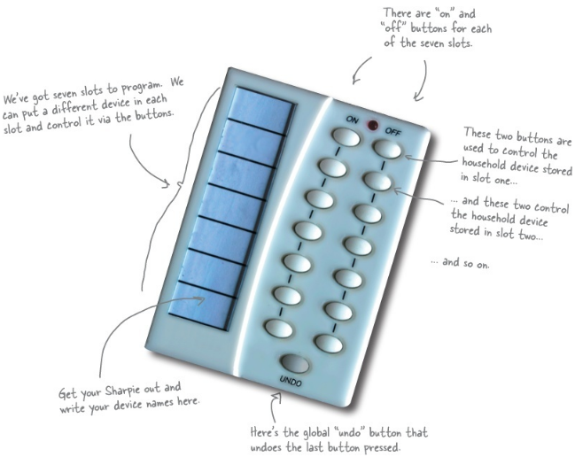

Slide 5
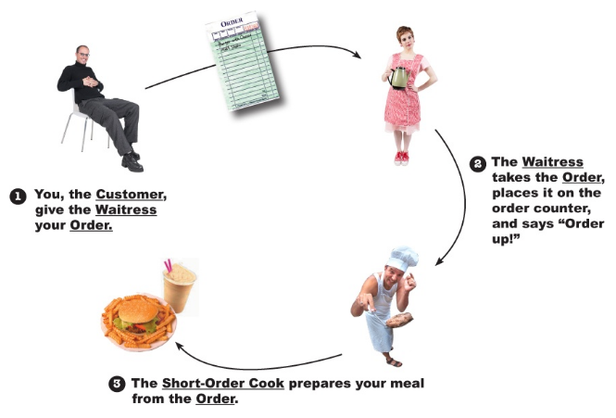
Restaurant analogy

Slide 6
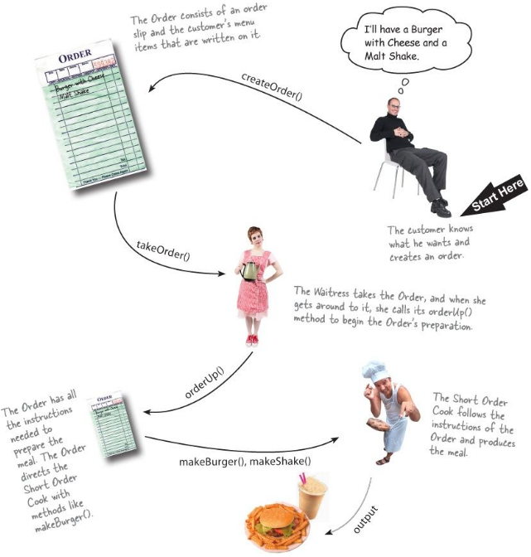

Slide 7
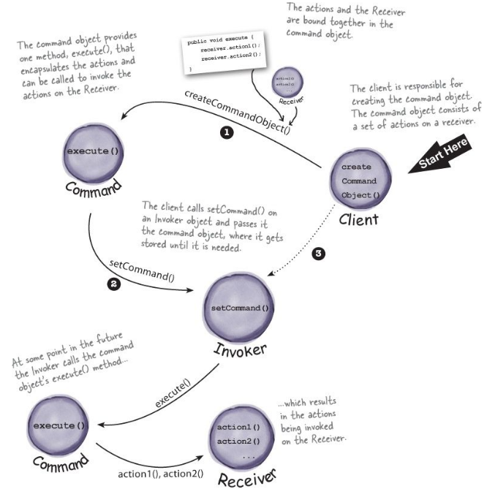

Slide 8

Command interface

Slide 9
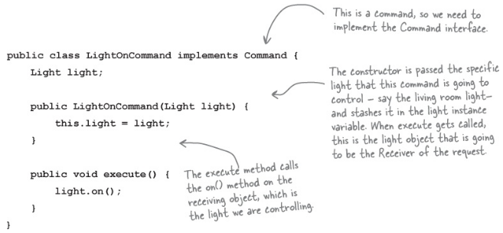
Implementing a command to turn a light on

Slide 10
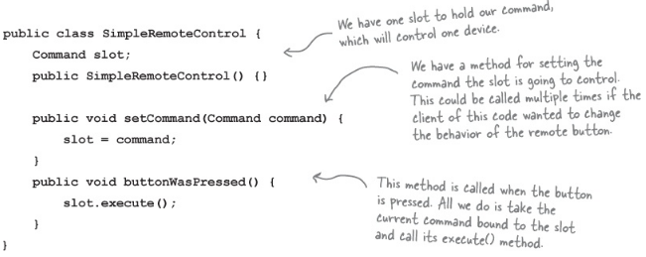
Using the command object

Slide 11
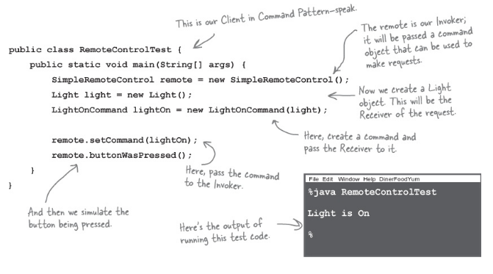
Creating a simple test to use the Remote Control

Slide 12
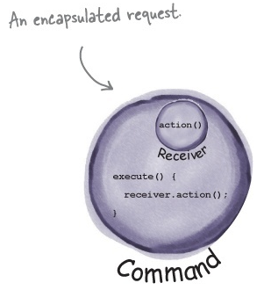
command object encapsulates a request by binding together a set of actions on a specific receiver

Slide 13
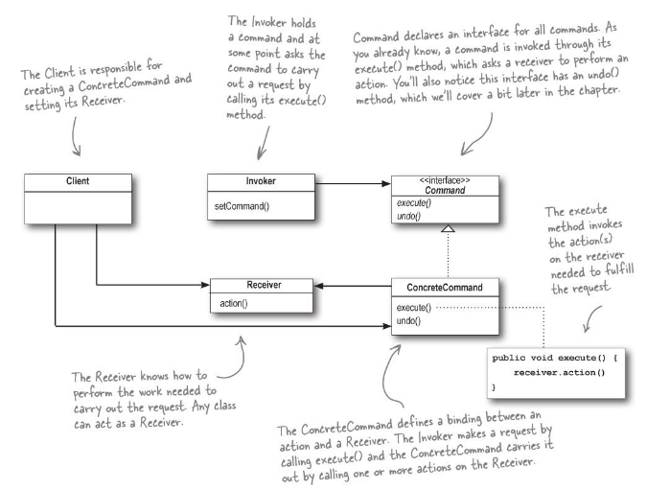
Command pattern

Slide 14
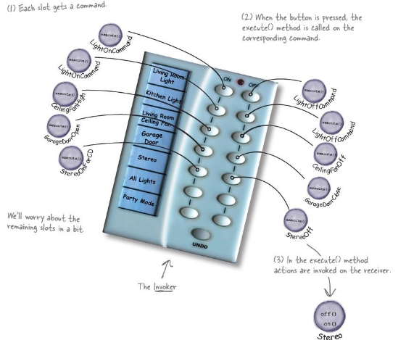

Slide 15
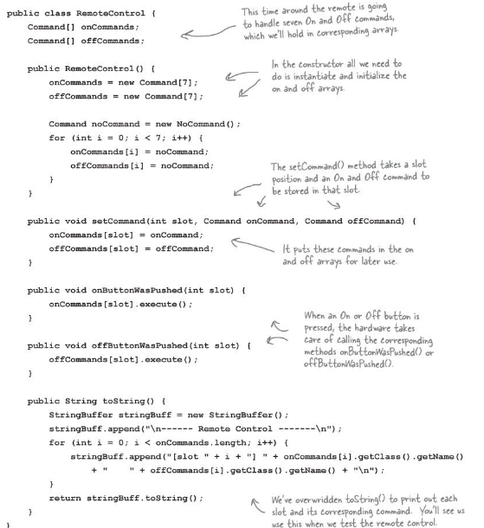

Slide 16
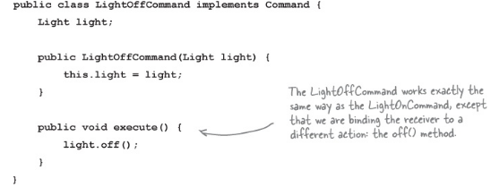
Command object

Slide 17
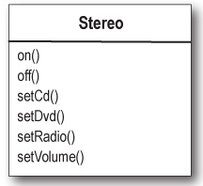
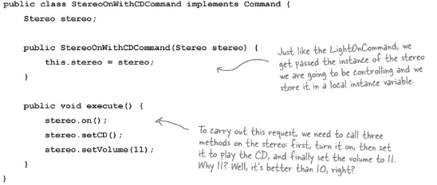
commandObject

Slide 18
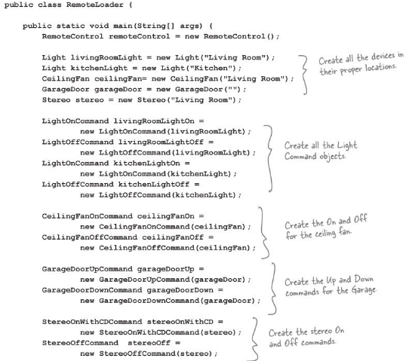

Slide 19
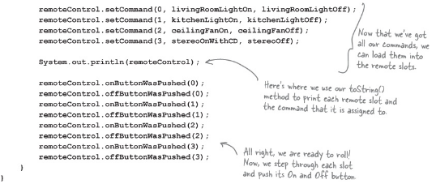

Slide 20
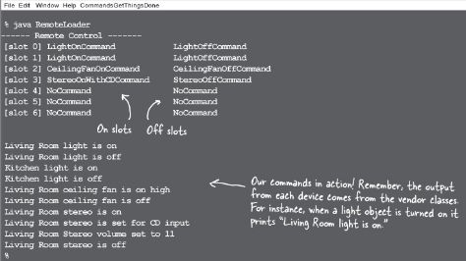

Slide 21



Note

Slide 22
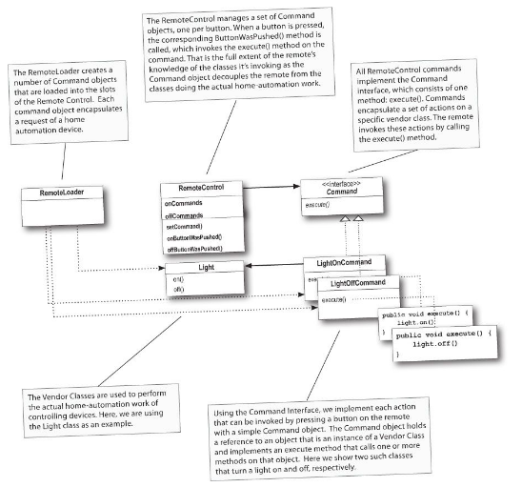

Slide 23
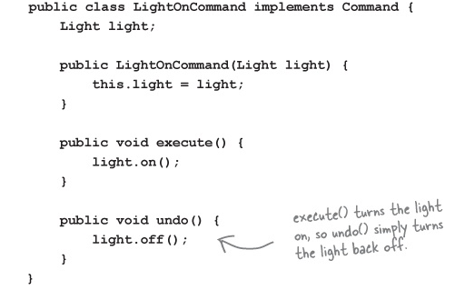
undo

Slide 24
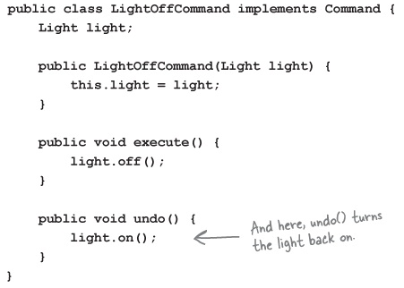
Undo in commandObject

Slide 25
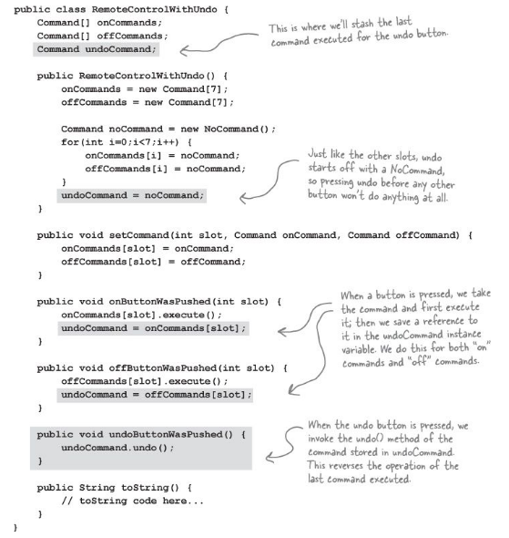
invoker

Slide 26
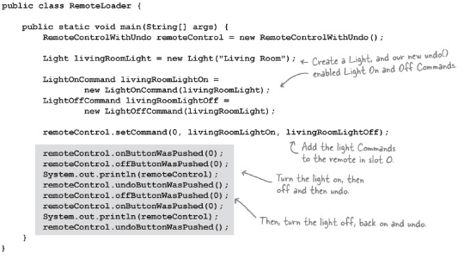
client

Slide 27
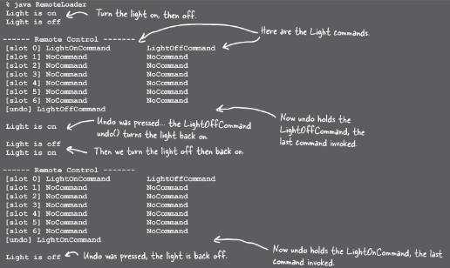

Slide 28
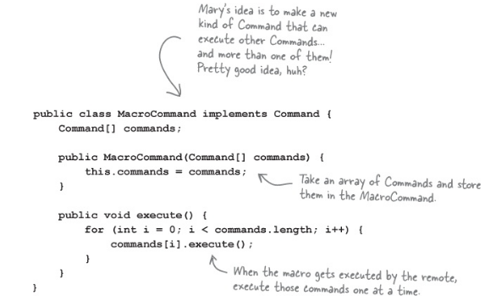
Party mode on

Slide 29
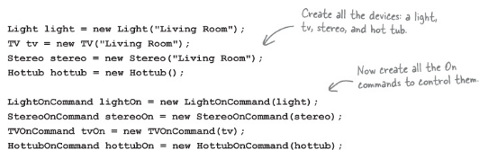
create the set of commands we want to go into the macro

Slide 30
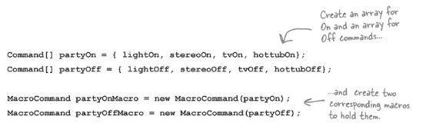
create two arrays, one for the On commands and one for the Off commands, and load them with the corresponding commands

Slide 31

assign MacroCommand to a button
we just need to push some buttons

Slide 32
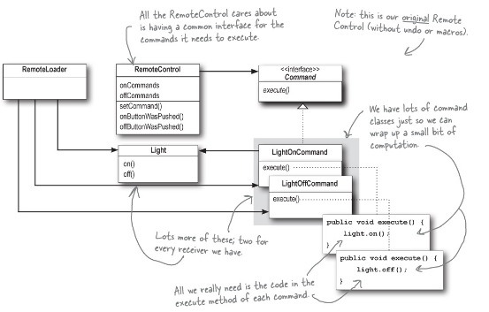
Summary

Slide 33
The Command Pattern encapsulates a request as an object, thereby letting you parameterize other objects with different requests, queue or log requests, and support undoable operations.

Slide 34
Questions

